Slide 1
KKBox Customer Churn Analysis
Members:
Lucky Hirani
Meghana Chowdary
Sameera Prasad
Sanjivani Gadkari

Slide 2
Business Problem:
KKBOX is Asia’s leading music streaming service, holding the music library with over 30 million tracks, offering generous, unlimited version of their service to millions of people, supported by advertising and paid subscriptions.
Users are discontinuing which is reducing the Business Sales of the company

Slide 3
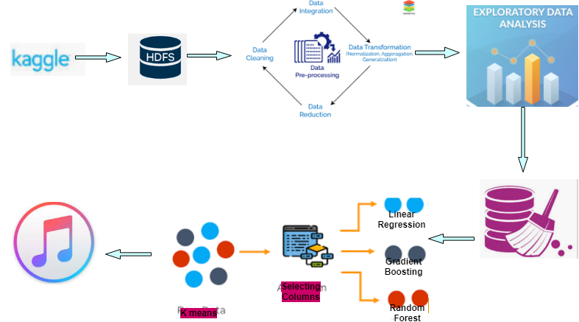

Slide 4
Data Description
Train
msno: user id,
is_churn: “is_churn=1” means churn, “is_churn=0” means renewal.
Transactions
msno: user id,
payment_method_id: payment method,
payment_plan_days: length of membership plan in days,
plan_list_price: in New Taiwan Dollar (NTD),
actual_amount_paid: in New Taiwan Dollar (NTD),
is_auto_renew,
transaction_date: format yyyy/mm/dd,
membership_expire_date: format yyyy/mm/dd,
is_cancel: whether or not the user canceled the membership in this transaction.

Slide 5
Data Description
User Logs
msno,
date
num_25: of songs played less than 25% of the song length,
num_50: of songs played between 25% to 50% of the song length,
num_75: of songs played between 50% to 75% of of the song length,
num_985: of songs played between 75% to 98.5% of the song length,
num_100: of songs played over 98.5% of the song length,
num_unq: of unique songs played, total_secs: total seconds played
Members
Msno,
city,
bd: age,
gender,
registered_via: registration method,
registration_init_time: format yyyy/mm/dd,
expiration_date: format yyyy/mm/dd,

Slide 6
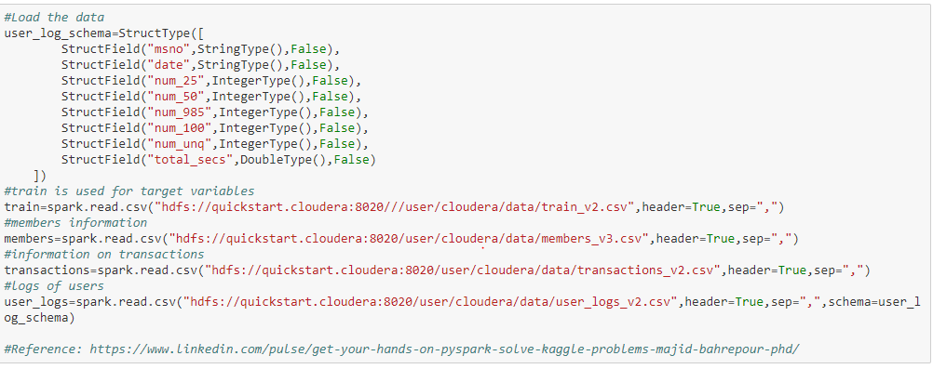

Slide 7
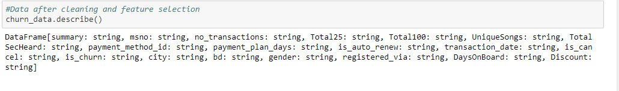

Slide 8
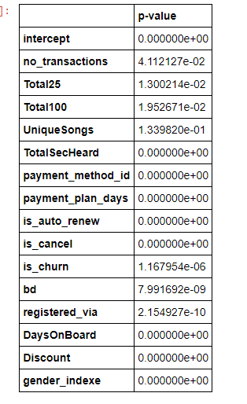
Models Applied
Linear Regression
We have applied linear regression to all the features in the dataset to find the P-values.

Slide 9
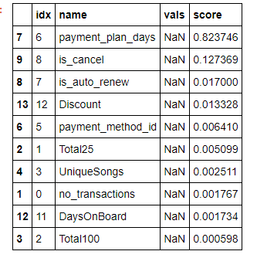
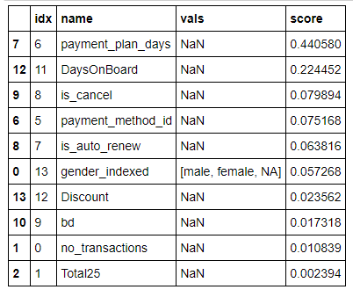
Gradient Boosted Trees and Random Forest (Feature Importance):

Slide 10
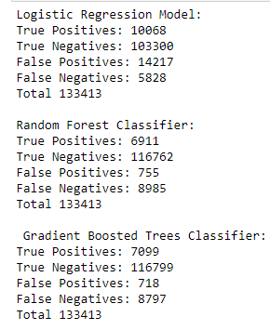

Comparison of Models

Slide 11
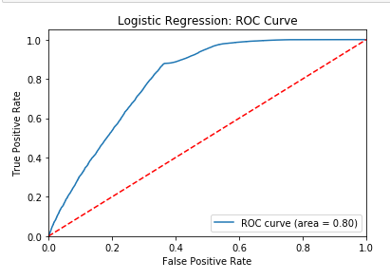
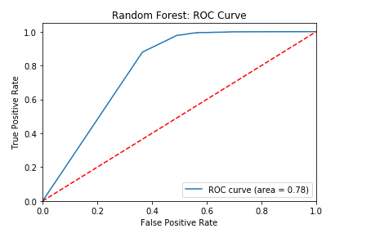
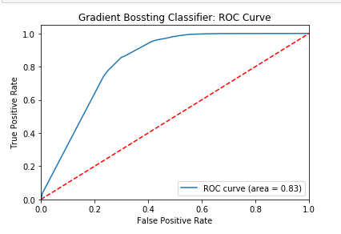

Slide 12
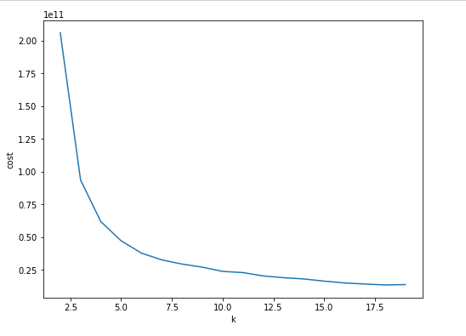
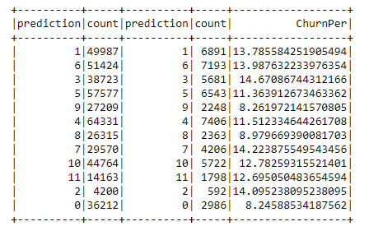
K Means Model

Slide 13
Conclusion:
Analyzed high and low value customers by studying the clusters 1, 5 and 6.
Clusters 1,5,6 have larger population than other clusters predicting more value
Cluster 1 and 6 have high amount of churn (~14%) with respect to the total number of people in it (49987 and 51424 ). RED CATEGORY - (High probability to churn).
Cluster 5 have lesser amount of churn (~11%) with respect to the total number of people in it(57577 ).GREEN CATEGORY ( high value customers with lowest probability of churn)

Slide 14
Recommendation and Findings
High value customers had less number of auto renewals. We recommend the KKBox marketing team to focus on manually renewing the subscriptions/ getting them on the auto renewal subscription plan.
Majority customers between 27-30 age.(Active Customers). KKBox teams should focus on marketing and upgrading according to the requirements of the age group.
Even with high churning, large number of these customers complete listening the entire songs. Recommendation of the same songs should be continued to avoid churning
KKBOX should give more discount to the customers to encourage the customers to hear more songs. More discounts for low value customers to avoid churning

Slide 15
Challenges
Understanding the data and cleaning was difficult as originally the data was around 8 GB
While finding the K mean, finding the optimal k value was time consuming.

